Slide 1


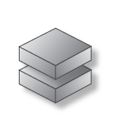
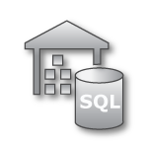

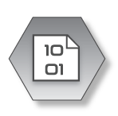
Modern Data Warehousing with Azure
LOB
CRM
INGEST
EXPLORE
PREP & TRAIN
MODEL & SERVE
BI + Reporting
Graph
Advanced Analytics
Image
Azure SQL Data Warehouse Azure Databricks
Azure Data Explorer
Azure Databricks
Azure SQL Data Warehouse
Real Time Analytics
Azure Data Factory
Social
STORE
IoT
Azure Data Lake Storage Gen2
Cloud

Slide 2

Real time analytics
INGEST
STORE
PREP & TRAIN
MODEL & SERVE
Sensors and IoT
(unstructured)
Azure Databricks
Logs (unstructured)
Apache Kafka for HDInsight
Cosmos DB
Real-time apps
Media (unstructured)
Files (unstructured)
PolyBase
Business/custom apps
(structured)
Azure Data Factory
Azure Blob Storage
Azure SQL Data Warehouse
Azure Analysis Services
Power BI
Microsoft Azure also supports other Big Data services like Azure IoT Hub, Azure Event Hubs, Azure Machine Learning and Azure Data Lake to allow customers to tailor the above architecture to meet their unique needs.
Notes:
Microsoft Azure supports other services like Azure HDInsight, Azure Data Lake, Azure IoT Hub, Azure Events Hub in various layers of the architecture above to allow customers a truly customized solution.

Slide 3
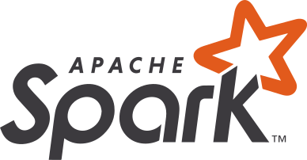
Azure Synapse Analytics
Limitless analytics service with unmatched time to insight
Artificial Intelligence / Machine Learning / Internet of Things
Intelligent Apps / Business Intelligence
Designed for analytics workloads at any scale
Synapse Analytics
SaaS developer experiences for code free and code first
Experience
Synapse Analytics Studio
Platform
Multiple languages suited to different analytics workloads
MANAGEMENT
Languages
MANAGEMENT
SQL
Python
.NET
Java
Scala
R
Integrated analytics runtimes available provisioned and serverless on-demand
SQL Analytics offering T-SQL for batch, streaming and interactive processing
Spark for big data processing with Python, Scala, R and .NET
SECURITY
Form Factors
SECURITY
PROVISIONED
ON-DEMAND
MONITORING
Analytics Runtimes
MONITORING
SQL
METASTORE
METASTORE
DATA INTEGRATION
Integrated platform services for, management, security, monitoring, and metastore
Azure
Data Lake Storage
Common Data Model
Enterprise Security
Optimized for Analytics
Data lake integrated and Common Data Model aware

